Slide 1
BookStore Project
Shah Divyesh Sureshbhai – 002922240
Gunasekhar Vinugolu – 001586178
Ajay Sureka – 002165619
Minal Pradeep Makwana - 002130495

Slide 2
Overview
In this Project, we have implemented following Design Patterns
State
Factory
Singleton
Strategy
Adapter
Decorator
Builder
Prototype
Command
Façade
Observer

Slide 3
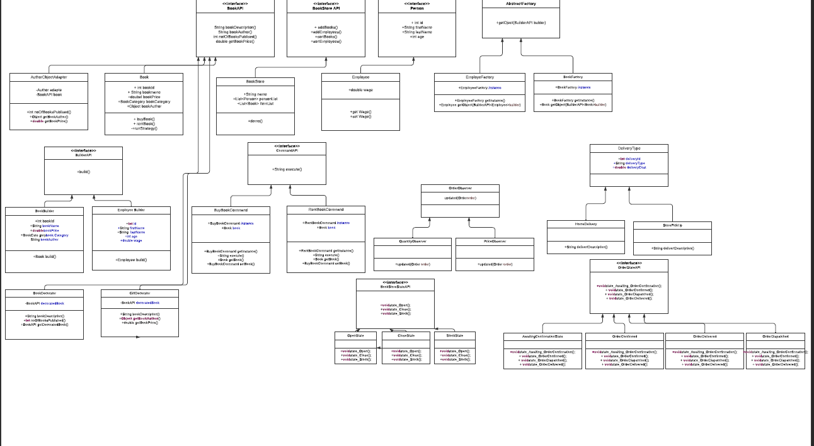

Slide 4
Contribution
Gunasekhar implemented the following design patterns :
Façade
Adapter
Prototype
Builder
Ajay implemented the following design patterns :
Observer
Strategy
Factory / Singleton
Divyesh implemented the following design patterns :
State
Decorator
Command
Minal implemented the following design patterns :
Prototype
Singleton / Factory
State

Slide 5
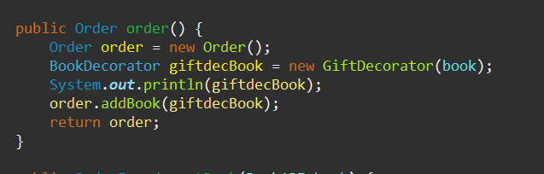
Façade Pattern
Designed OrderFacade class which accepts Book Object through Object Composition
Also contains order() creating new Order Object, book is decorated and added to Order

Slide 6
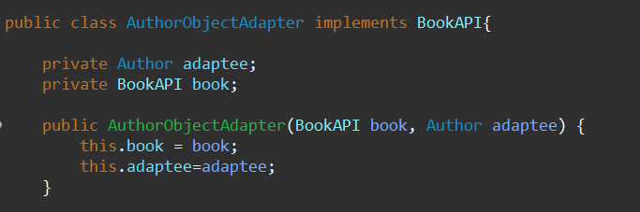
Adapter
Designed AuthorObjectAdapter which implements BookAPI and contains Author and Book object
Purpose of this class is to collaborate the Author class which implements Cloneable with Book class

Slide 7
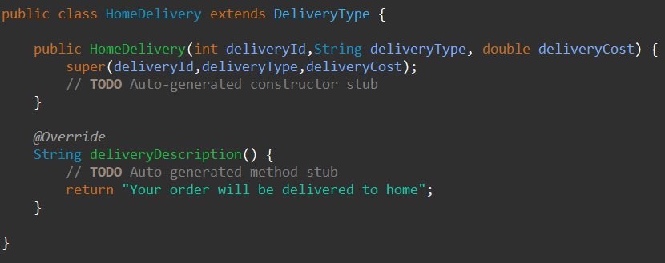
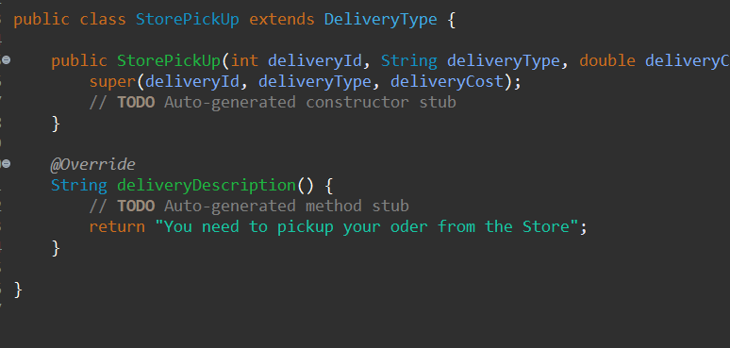
Prototype
Created Delivery Service to demonstrate the use of Prototype Pattern
Designed abstract DeliveryType class which implements Cloneable and having following attributes:
deliveryType
deliveryId
deliveryCost
Derived two classes named HomeDelivery and StorePickUp extending DeliveryType and overriding deliveryDescription()

Slide 8
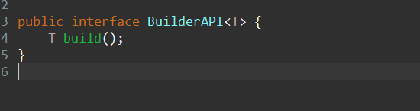
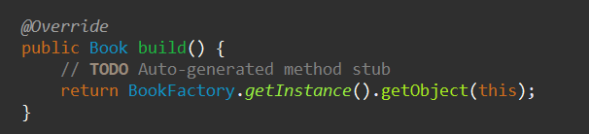
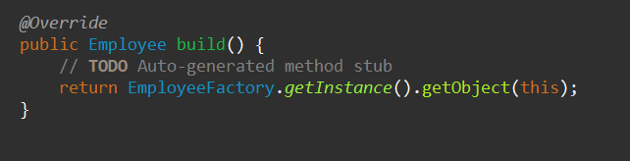
Builder
Designed Generic Builder interface named BuilderAPI containing following method :
T build()
Derived EmployeeBuilder and BookBuilder class implementing BuilderAPI which creates objects of respected class by invoking respective factories

Slide 9
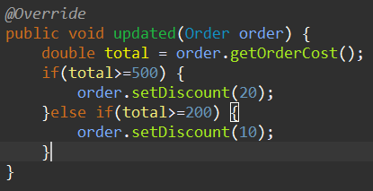
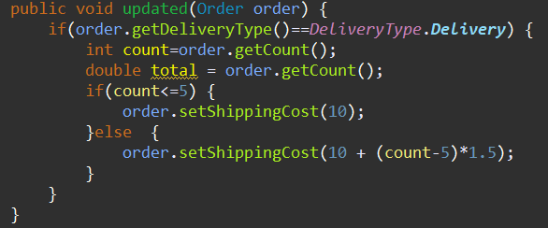
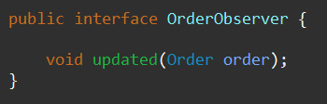
Observer
Created OrderObserver interface containing updated() which takes Order object as an argument.
Dervied two classes named as PriceObserver and QuantityObserver which implements OrderObserver interface
PriceObserver will decide discount based on Total Order Amount
QuantityObserver will decide the deliveryCost based on the quantity of the order

Slide 10
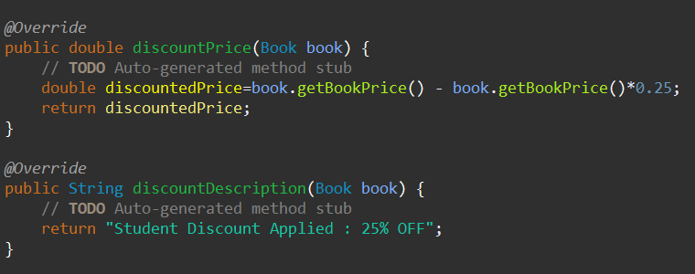
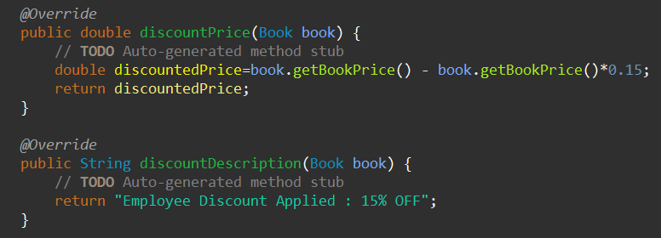
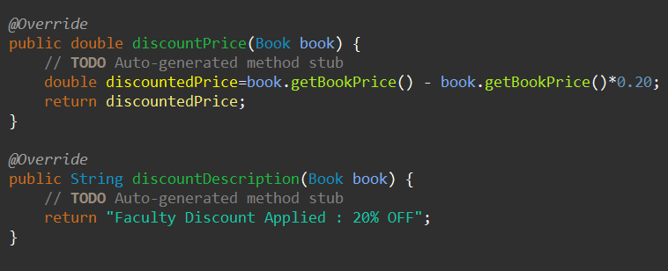
Strategy
Created DiscountStrategyAPI interface wjich contains following methods
discountedPrice()
discountedDescription()
Derived 3 classes named as EmployeeDiscount, FacultyDiscount and StudentDiscount which implements DiscountStrategyAPI

Slide 11
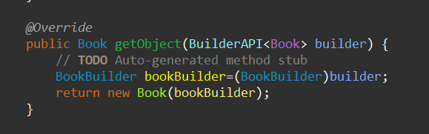

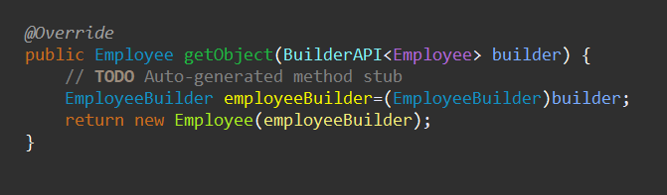
Factory / Singleton
Designed AbstractFactory interface which has getObject()
Created two derived classes named as BookFactory and EmployeeFactory which implements AbstractFactory interface.
getObject() uses builder object of that respective class to create objects of respective data type.

Slide 12
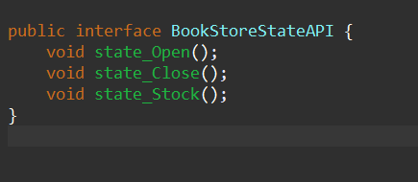
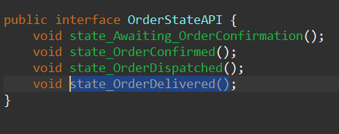
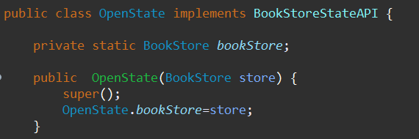
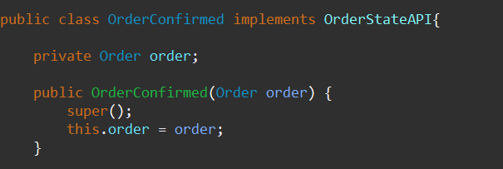
State
Created Two Interface i.e. BookStoreStateAPI and OrderStateAPI
Derived 3 classes from BookStoreStateAPI which implements following methods :
state_Open(), state_Close(), state_Stock()
Derived 4 classes from OrderStateAPI which implements following methods :
state_Awaiting_OrderConfirmation(), state_OrderConfirmed(), state_OrderDispatched(), state_OrderDelivered()
BookStore implements BookStoreStateAPI and Order implements OrderStateAPI

Slide 13
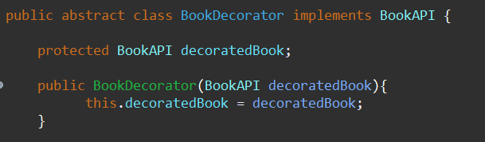
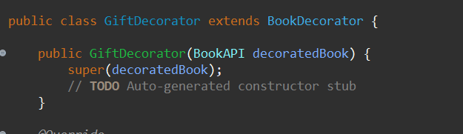
Decorator
Designed abstract class BookDecorator implements BookAPI
Main purpose of this Design Pattern is to wrap up the existing object
Created GiftDecorator which inherites BookDecorator to add functionality to existing book object.

Slide 14
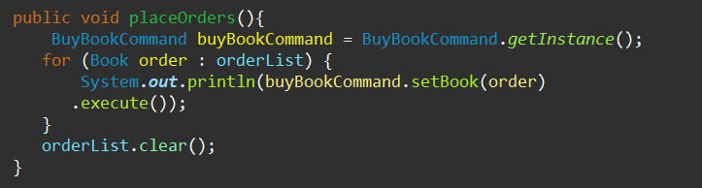
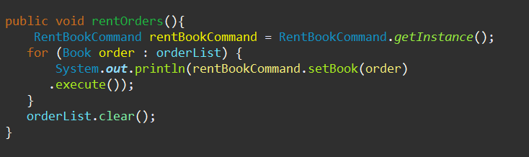
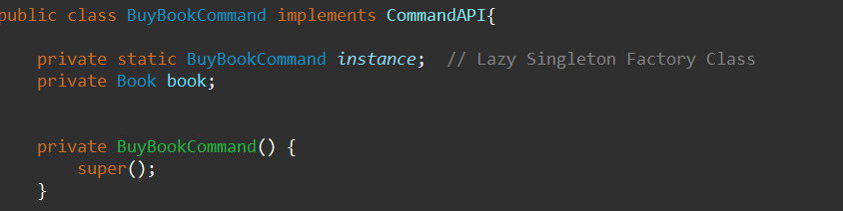
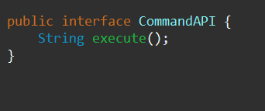
Command
Designed CommandAPI interface which includes excute()
Purpose of this Pattern is to pass command of either “buying” or “renting” a book
Derived BuyBookCommand and RentBookCommand classes from CommandAPI
Created Invoker Class which invokes specific objects which performs the command passed by the receiver.

Slide 15
Thank you Professor

